Slide 1



Advance Analog and Mixed Signal Design
Lecture 7
Amplifier Stability
Dr. Neeraj Mishra
High Performance Electronics Lab
Electrical & Electronics Eng. Dept.
Birla Institute of Technology & Science Pilani, Pilani Campus

Slide 2
Motivation
Operational amplifiers are a universal building block and most analog designers will design one
An oscillating amplifier is a designer’s nightmare and leads to revisions. Gain peaking or settling tails can be detrimental to system performance
From practice, more time is spent on assuring the amplifier’s stability under all conditions than on other features
Return of Investment (ROI): time saved > time spent

Slide 3
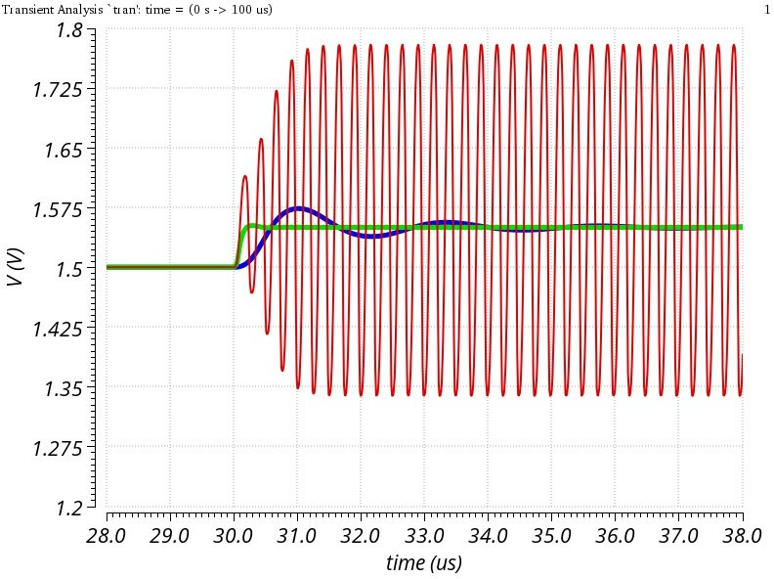
Stability
Definition of stability
1 : the quality, state or degree of being stable:
the strength to stand or endure
the property of a body that causes it when disturbed from a condition of equilibrium or steady motion to develop forces or moments that restore the original condition
resistance to chemical change or physical disintegration
voltage
time
We will focus primarily on small signal stability, touch upon large signal (conditional) stability. We will not cover stability over temperature or time.

Slide 4
Benefits and Challenges
There are over 15000 commercially available operational amplifiers and much more integrated inside mixed-signal ICs
Variety is due to the many different optimization objectives
They must be robust in variety of operating conditions and feedback variations
For optimum performance one must trade-off conflicting requirements
Poor compensation leads in worse case to system failure and in best case to wasted power and area
Concepts are applicable to other circuits (i.e. regulators, references, etc.)
Speed
Speed
Speed
Power
Power
Voltage
Accuracy
Accuracy

Slide 5
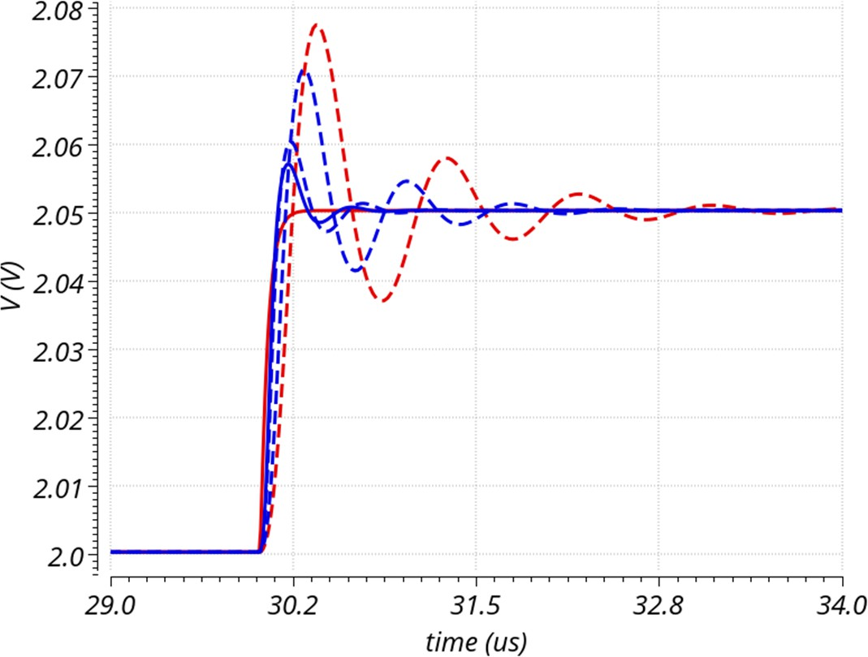
Stable (enough?)
Stability requires power, die area, complexity and time investments
Depends on operating conditions, load and system configuration
Impact key amplifier parameters such as speed, power, settling time but difficult to benchmark
Vout
𝐺𝐵𝖶 _{G} 𝐺𝐵𝖶 _{G} 𝐺𝐵𝖶·𝐶_{𝐿𝐷 G} 𝐺𝐵𝖶·𝐶_{𝐿𝐷}·𝜑_{𝑀}
𝐼_{Q} 𝐼_{Q}·𝑉_{𝐶𝐶} 𝐼_{Q}·𝑉_{𝐶𝐶} 𝐼_{Q}·𝑉_{𝐶𝐶}
𝐹𝑂𝑀:
time

Slide 6
Outline
Introduction and background
Refresher on feedback theory, bode plots and gain and phase margin
Amplifier frequency response
Basic compensation techniques
Alternative (advanced) compensation schemes
Practical tips and suggestions

Slide 7
Outline
Introduction and background
Refresher on feedback theory, bode plots and gain and phase margin
Amplifier frequency response
Feedback theory Poles, zeros Bode plots Stability criterion
Basic compensation techniques
Alternative (advanced) compensation schemes
Practical tips and suggestions

Slide 8
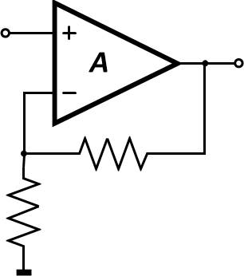
Ideal Amplifier
Integrated amplifiers can have large gain (80-140dB), but it is very process, temperature, supply dependent
Need feedback to eliminate these dependencies. Passive feedback elements such as resistors offer better stability and linearity
Many amplifier parameters will be controlled by local feedback loops and therefore amplifiers are interacting multi-loop systems
Vin
Vout
Rf
Rin

Slide 9



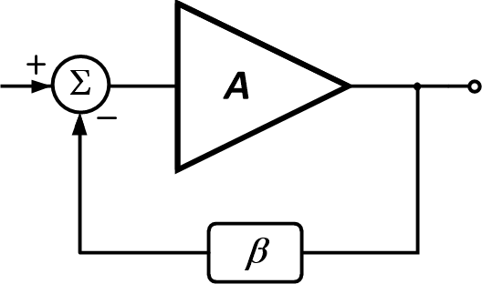

Feedback Concept
Compare the input signal to a sensed copy of the output
The difference (error) is amplified
The output is driven to the desired amplitude
A: Open Loop Gain
Input
Output
Aβ
Aβ: Loop Gain (T)
(Return Ratio)
The accuracy now mainly determined by the feedback network
β: Feedback Factor
1/β : ~ Closed Loop Gain (A )
CL

Slide 10



Feedback Concept
Negative Feedback
  Increases accuracy (with accurate β)
  Reduces sensitivity to gain variations
  Linearizes system
  Improves input/output impedance
  Provides more usable bandwidth
However
Input
Output
𝐴
1/𝛽
𝐺𝑎𝑖𝑛 =
=
1 + 𝐴𝛽 1 + 1/𝐴𝛽
Lowers achievable gain
Increases area and complexity
Can lead to instability
For voltage (series-shunt) feedback:
^{𝑅}𝑜𝑢𝑡
𝑅 = 𝑅 (1 + 𝐴𝛽)
^{𝑅}𝑜𝑢𝑡𝐹𝐵 ⁼
𝑖𝑛𝐹𝐵
𝑖𝑛
(1 + 𝐴𝛽)

Slide 11
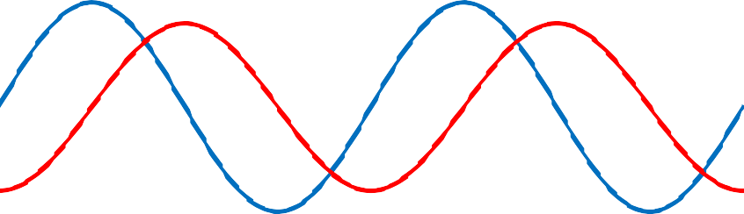


Frequency Dependence
The open loop gain (A) and feedback factor (β) do not stay constant over frequency
Feedback loop has to be analyzed over frequency
Input
amplitude
A(jω)
Output
phase delay
β(jω)
1
𝛽(𝑗𝜔)
𝑉
𝐶𝐿 𝐺𝑎𝑖𝑛 = ^{𝑜𝑢𝑡𝑝𝑢𝑡} =
1
𝐴(𝑗𝜔)𝛽(𝑗𝜔)
^{𝑉}𝑖𝑛𝑝𝑢𝑡
1 +
𝜔[𝑟𝑎𝑑/𝑠] = 2𝜋𝑓[𝐻𝑧]
𝑇(𝑗𝜔) = 𝐴(𝑗𝜔)𝛽(𝑗𝜔)

Slide 12


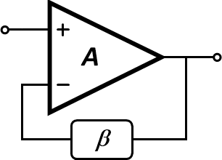
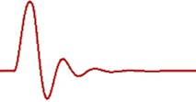

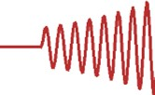




Negative and Positive Feedback
With too much delay in the signal fed back (phase shift) in the system the negative feedback can become positive leading to increasing output and therefore instability.
Negative Feedback
Positive Feedback
+ delay

Slide 13
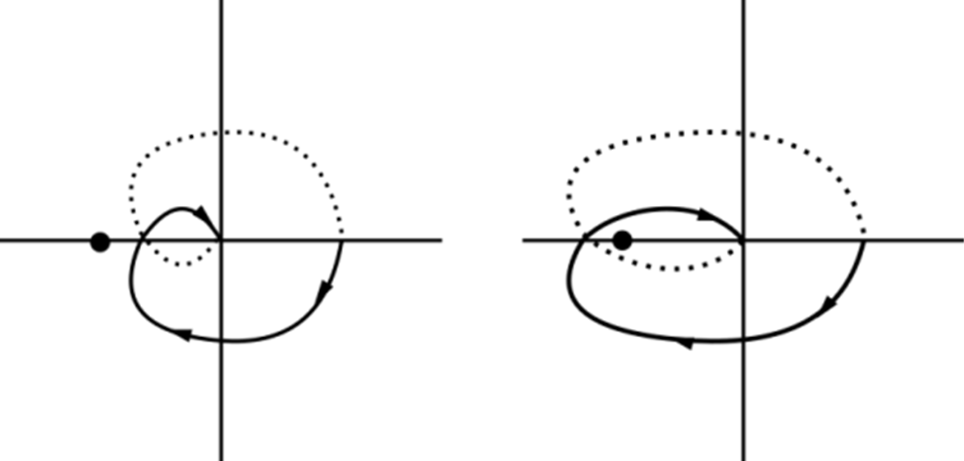


Feedback Stability: Nyquist Stability Criterion
The Nyquist plot is obtained by tracing in the complex plane the magnitude and phase of the loopgain T(jω) from ω=0 to ω=j∞
Based on Nyquist Stability Criteria (1932) for a feedback amplifier (without right half plane poles) a necessary and sufficient condition for stability is that the Nyquist plot in the T(jω) plane of the loopgain T(jω) does not encircle the
-1+j0 (180°) [1,17]
Im Im
ω=∞ ω=∞
j𝜔 j𝜔 ω=0 ω=0
1 + _{𝜔𝑧1} 1 + _{𝜔𝑧2} …
T(j𝜔) = 𝐴
0
₁ ₊ j𝜔
₁ ₊ j𝜔
…
-1 -1
Re Re
^{𝜔}𝑝1
^{𝜔}𝑝2
Stable
Unstable

Slide 14
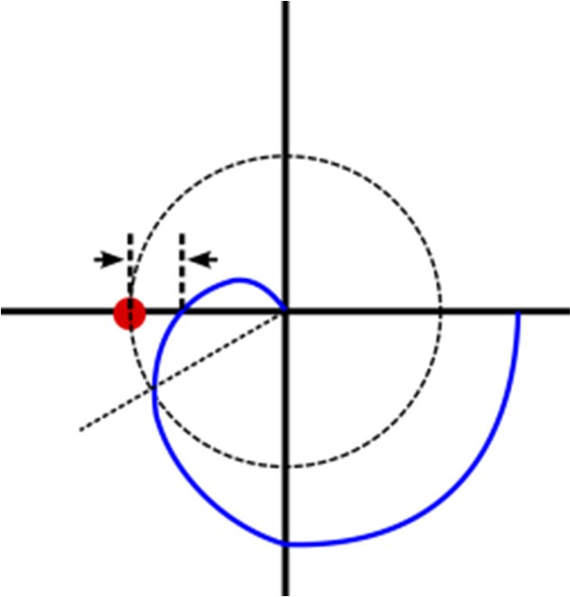


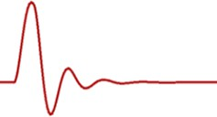
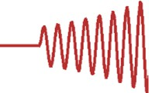
A practical simplification
For most practical feedback amplifier cases we aim to assure that the frequency where the phase is inverted (-180°) the magnitude of the loopgain is attenuated (below 1=0dB)
Im
G_{M}
_{φM}-1
Re
|T| at f₁₈₀ < 1
|T| at f₁₈₀ > 1

Slide 15
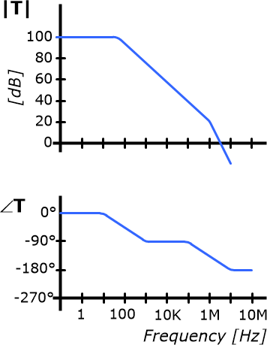
Bode Plots: Refresher
A graphical method to represent the small signal frequency response of a system at a particular operating point
Useful to understand trends for stability by looking at gain or loopgain magnitude and phase
Always follow up by transient simulations and disturbances!
₁ ₊ j𝜔
₁ ₊ j𝜔
…
|𝐓| = 20𝑙𝑜𝑔₁₀|𝑇 𝑗𝜔 |
T(j𝜔) = 𝐴₀
^{𝜔}𝑧1
^{𝜔}𝑧2
₁ ₊ j𝜔
₁ ₊ j𝜔
…
𝜔
^{𝜔}𝑧1,2..
𝜔
^{𝜔}𝑝1,2..
^{𝜔}𝑝1
^{𝜔}𝑝2
∠𝐓 = Σ 𝑡𝑎𝑛⁻¹
− Σ 𝑡𝑎𝑛⁻¹
𝜔[𝑟𝑎𝑑/𝑠] = 2𝜋𝑓[𝐻𝑧]

Slide 16
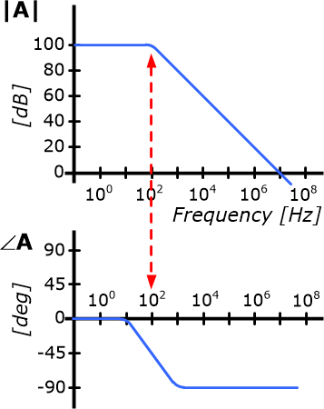
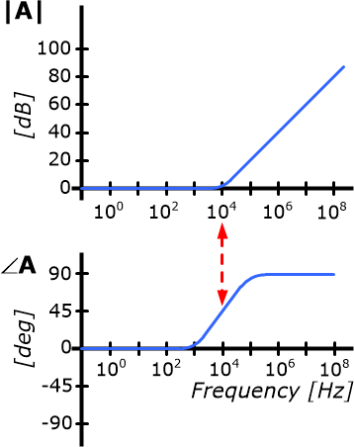


Bode Plots: LHP Pole and Zero
Bode Plot: LHP Pole Bode Plot: LHP Zero
-3dB at f_{p}
-20dB/dec
+20dB/dec
+3dB at f_{z}
90°
45° at f_{z}
+45/dec 0°
0°
-45/dec
-45° at f_{p}
-90°

Slide 17
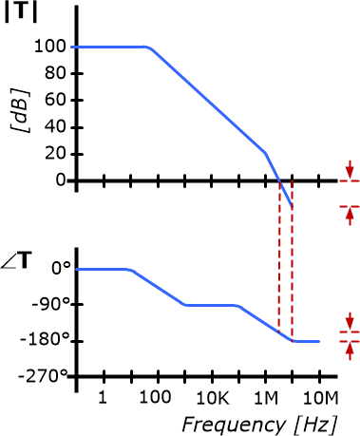
Gain and Phase Margin
From Nyquist Criterion the degree of a system’s stability can be quantified by:
Phase Margin (φ_{M}): The phase at the frequency where the loopgain
(T) is 0dB (referenced to -180°)
G_{M}=20dB
Gain Margin (G_{M}): The attenuation where the phase of the loopgain
(T) has reached 180°
φ_{M}=22°

Slide 18
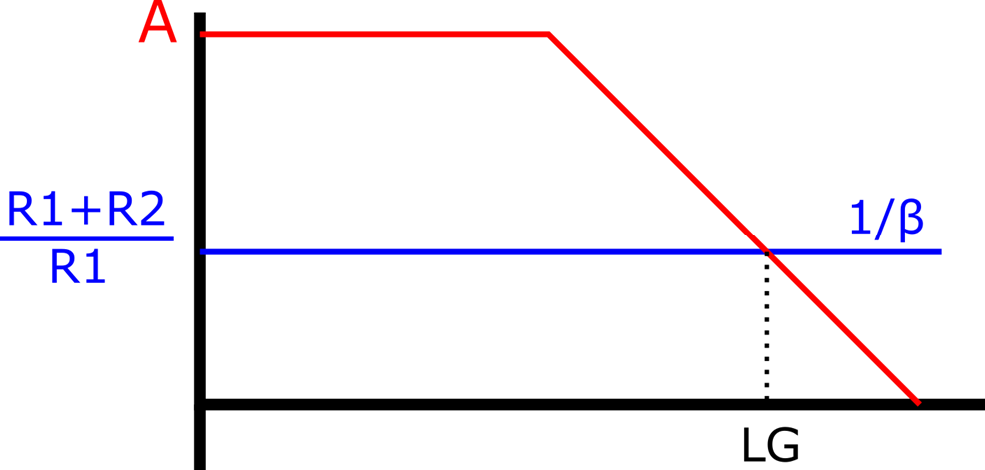
Op amp Feedback Stability: Graphical Method
Vin
Loopgain T = Aβ
Log(T) = Log(A) + Log(β)
Log (T) = Log(A) – Log(1/β)
Vout
R2
R1
Use above equation in a plot:
Separately plot 20Log(A) and 20Log(1/β)
Loopgain is difference of curves, unity gain is where lines cross
For stability loopgain needs to cross unity with 20dB /decade roll-off
β
19

Slide 19
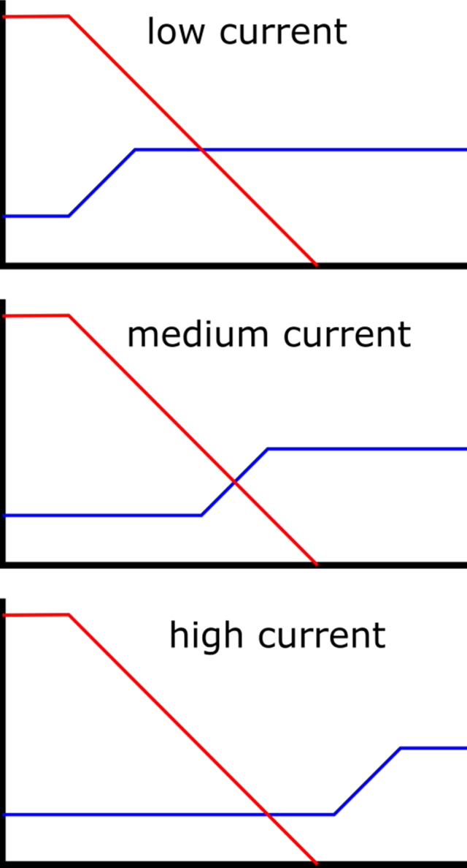
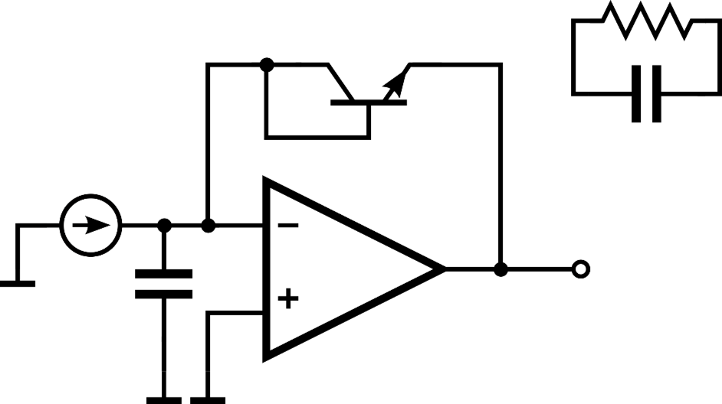
Op amp Feedback Stability: Graphical Method
r_{D}
A
stable
1/β
Q_{D}
C_{D}
^{C}IN
unstable
r_{D} = 1/gm of Q_{D} (current dependent) C_{D} = parasitic diode capacitance
stable
1
1
2𝜋𝑟_{𝐷}𝐶_{𝐷}
𝑓 =
𝑓 =
𝑧
2𝜋𝑟_{𝐷}(𝐶_{𝐷} + 𝐶_{𝐼𝑁})
𝑝

Slide 20
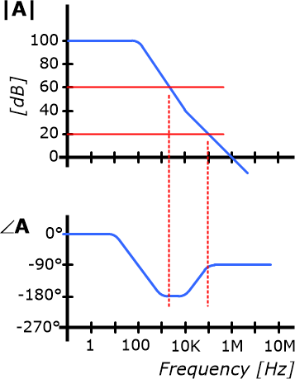
Op amp Feedback: Conditional Stability
Stable if feedback network is restricted to certain values
  Unstable with CL gain > 20 (26dB)
  Stable with CL gain < 20 (26dB)
A
1/β
-40dB/dec.
-20dB/dec.
1/β
Much improved power efficiency
φ_{M}=90°
Careful in any condition that can lead to loss of open loop gain!
φ_{M}=0°

Slide 21
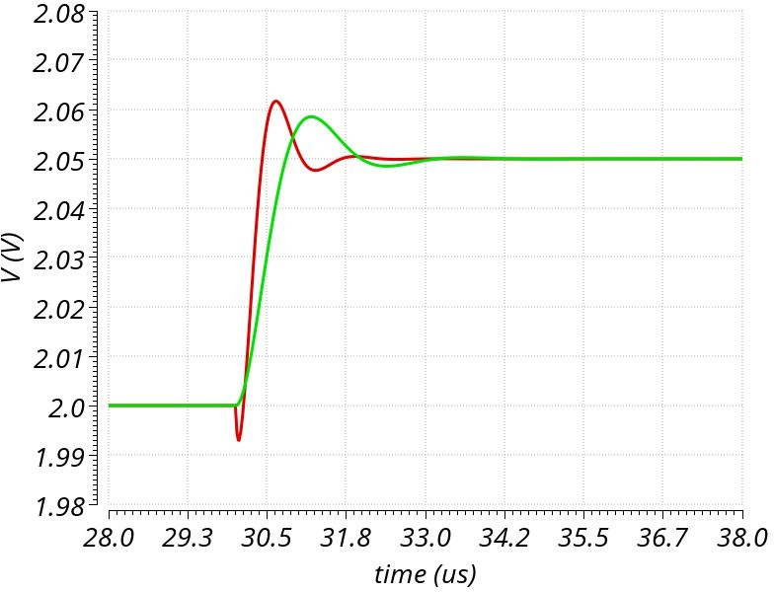
Bode Plots: LHP vs RHP Pole and Zero
Pole magnitude decreases with frequency, zero increases with frequency
LHP pole or RHP zero phase decreases with frequency
  RHP zero reduces phase margin!
  Commonly found in circuits (i.e. Miller capacitance feed-forward)
RHP pole or LHP zero phase increases with frequency
  RHPP lead to system instability
  Not known [?] in amplifiers
voltage
time

Slide 22
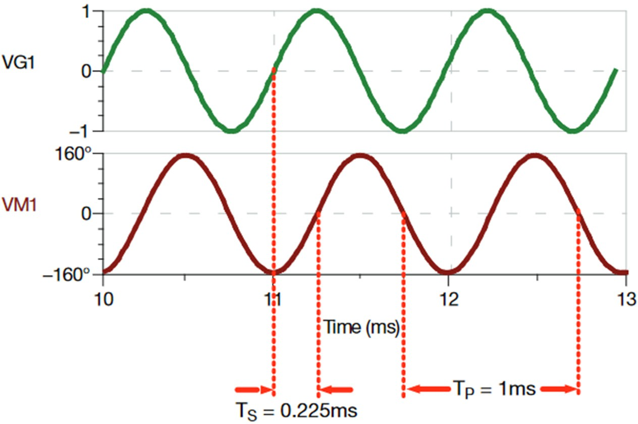
Relating to Transient Response ^{[19]}
Time to phase shift
T_{S}: time shift from input to output signal T_{P}: period of signal
θ: phase shift of the signal from input to output
Vin
Vf
To calculate phase shift in degrees:
Time(ms)
0.225𝑚𝑠
𝜃 = ^{𝑇𝑆} · 360° =
· 360° = 81°
T_{S}=0.225ms
T_{P}=1ms
𝑇_{𝑃}
1𝑚𝑠

Slide 23
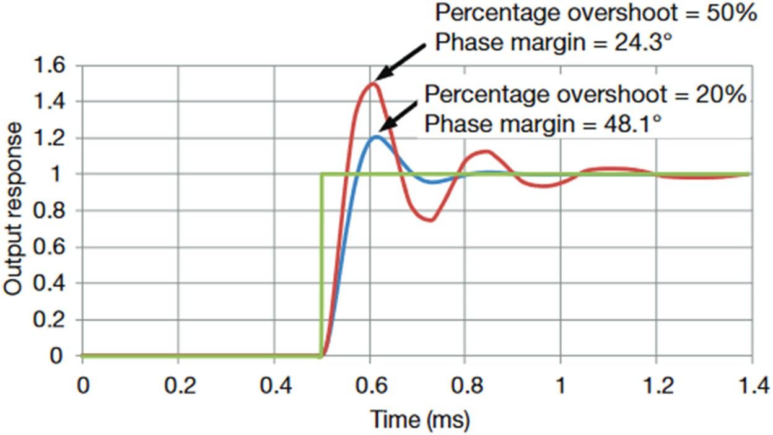
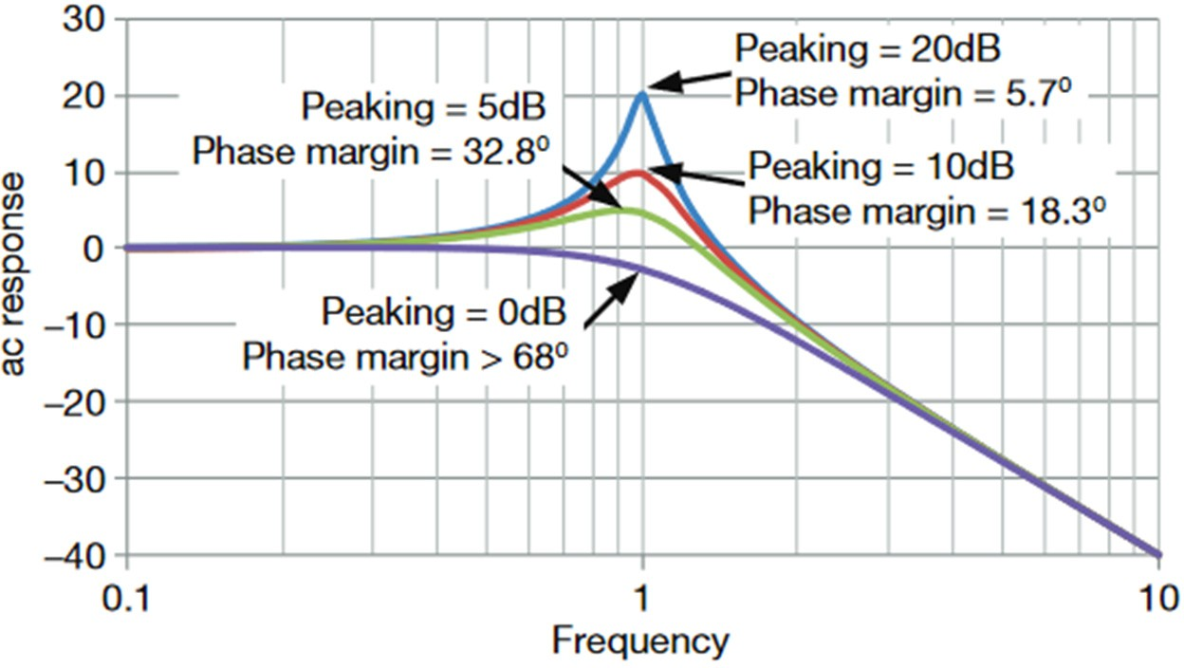
Relating to Transient Response ^{[19]}
Dominant (2 pole) system responses
Small-step overshoot AC Response vs. Frequency

Slide 24
Outline
Introduction and background
Refresher on feedback theory, bode plots and gain and phase margin
Amplifier frequency response
Basic compensation techniques
Causes of poles and zeros Number of gain stages
Alternative (advanced) compensation schemes
Practical tips and suggestions

Slide 25
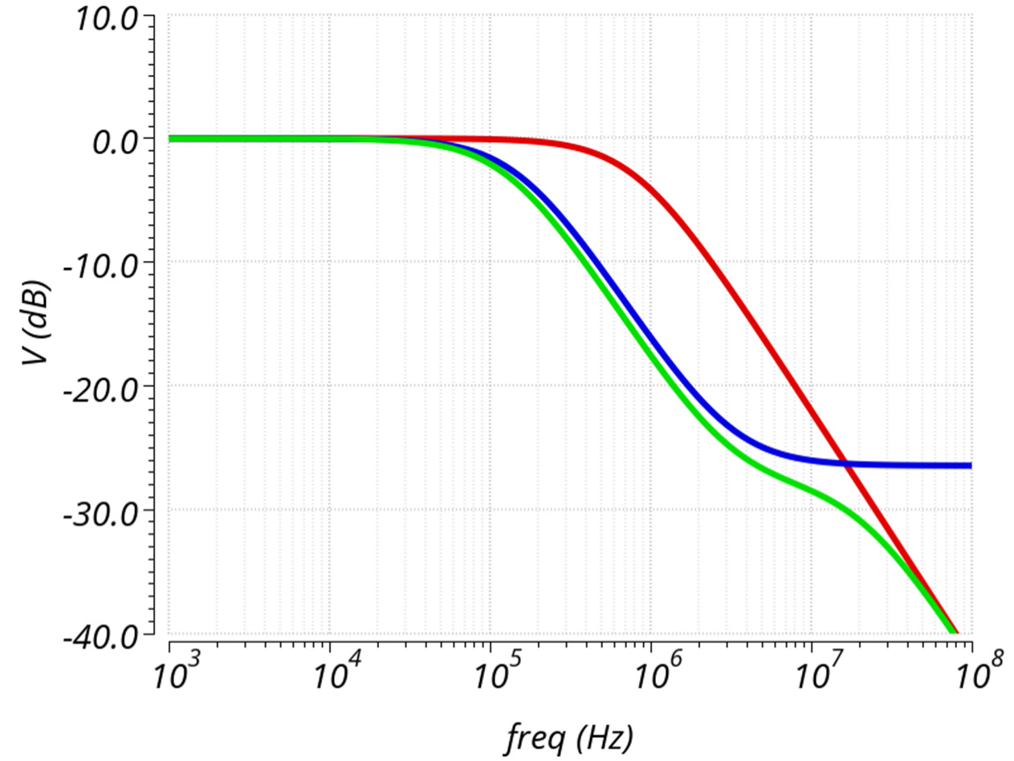
Trends to Remember
|vx/vin|
100KΩ
vx
Zld 5KΩ
2pF
Vin
Zld:
2pF 5K&10pF
(5K&10pF)||2pF
10pF

Slide 26
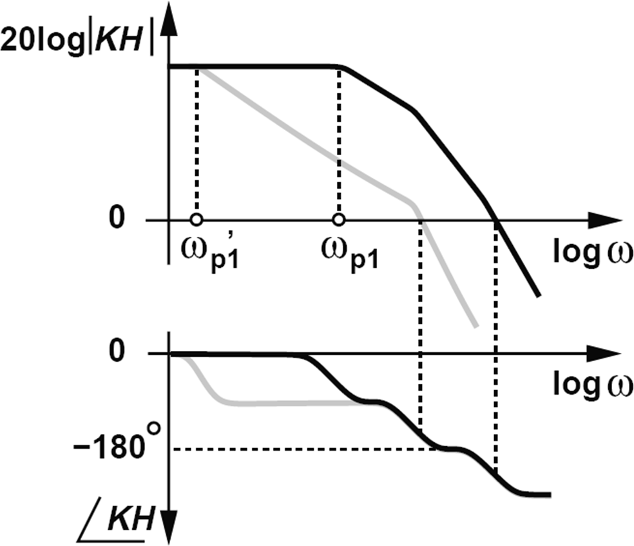
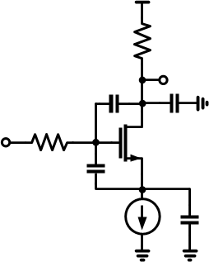
Frequency response of an amplifier^{[20]}
Parasitic capacitances as well as multiple gain paths introduce poles and zeros in the frequency response.
R_{L}
^{C}GD ^{V}OUT ^{C}GD
R_{S}
^{V}IN
^{C}GS
^{C}SB

Slide 27
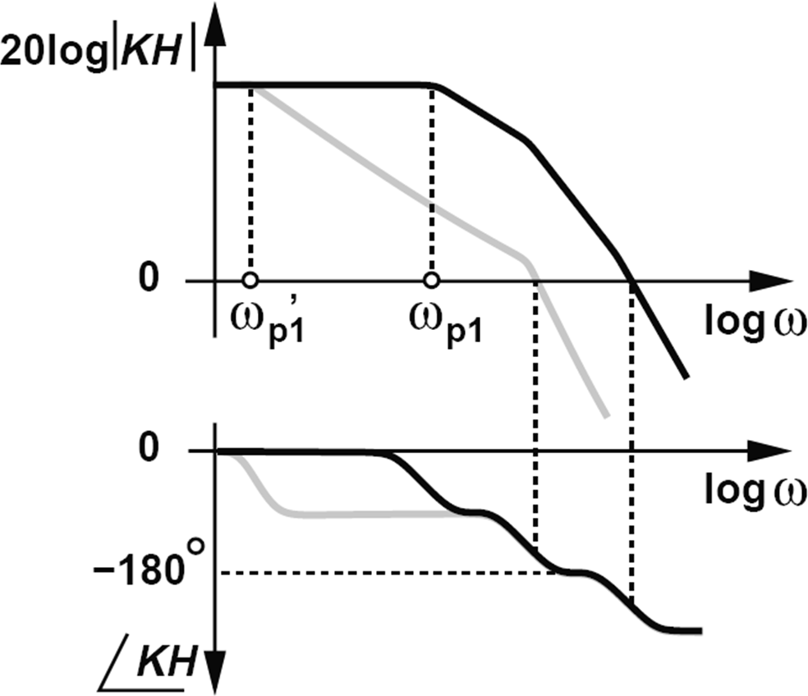
Frequency compensation
Introduces elements in the feedforward or feedback path to ensure needed phase and gain margin for stability
^{ω}p1
^{ω}p2
Reduces dependency on parasitic elements and their variation over process/temperature/supply in the circuit
Always comes with reduction of power to bandwidth ratio
Figure [20]

Slide 28
Amplifiers: Number of stages
1 Stage Amplifiers
  Simplicity, stability and power efficiency (++)
  Low gain, high output impedance, limited output range, load sensitivity, limited current drive capability (––)
2 Stage Amplifiers
  Lower output impedance, output range, load insensitivity, input and output ranges decoupled, current drive capability (++)
  Simplicity, cap load drive, settling time, power efficiency (+)
  Limited gain, higher offset and noise, distortion, current drive capability (bipolar amplifiers) (–)
3 Stage Amplifiers
  High gain, lower offset and noise, less distortion, current drive capability (bipolar amplifiers) (++)
  Complexity, power efficiency, large and small signal stability concerns (––)

Slide 29
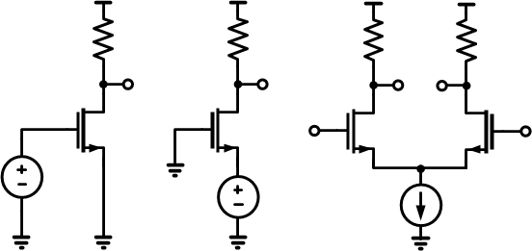
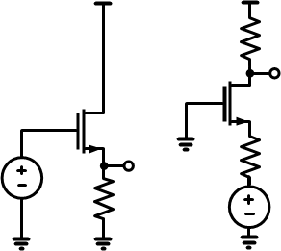
What is a gain stage in the signal path?
^{R}LD
^{R}LD
^{R}LD ^{V}OUT
^{R}LD
^{R}LD
^{V}OUT
V
OUT
V
OUT
^{V}IN
^{V}IN
^{V}OUT
LD
^{R}IN
^{V}IN
V
IN
V
IN
V
IN
R
Gain stages:
  common source
  common gate if Zin << ZL
  differential stage
Not gain stages:
common drain (follower)
common gate if Zin > ZL

Slide 30
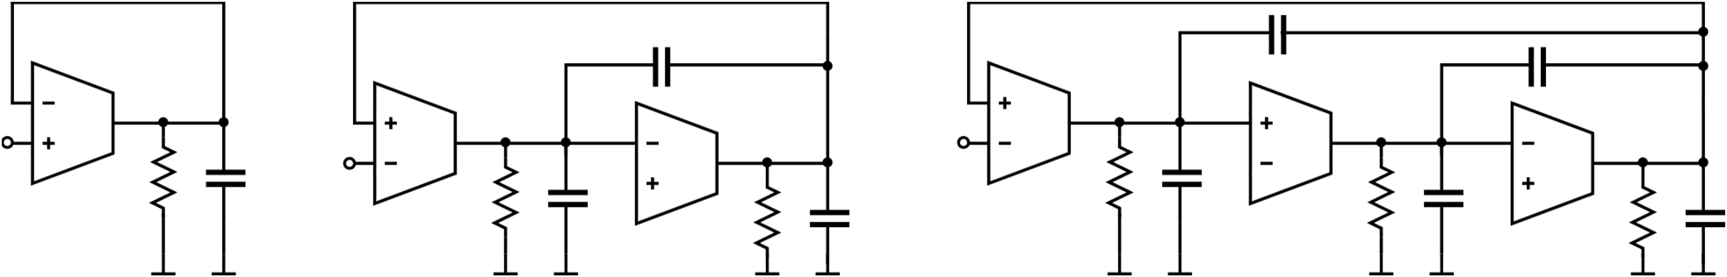
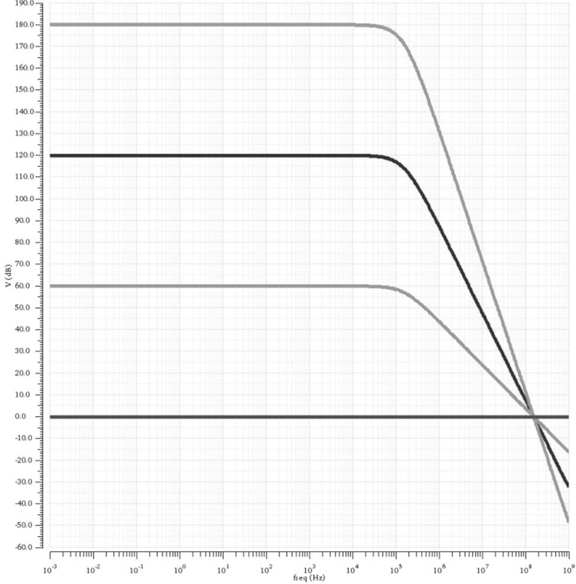
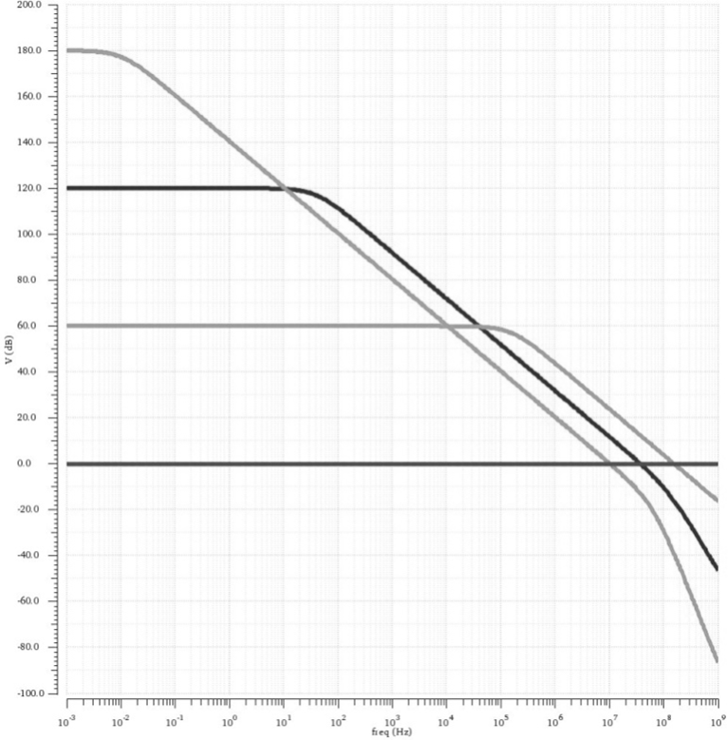
More stages → lower achievable bandwidth
^{C}m2 G₂
C
M1
G₁
C
M1
V
G₁
G₁
V
IN
^{V}IN
^{R}0 ^{C}LD
G
IN
G
2
3
R₀ C₀
R₀
^{C}LD
R₀ C₀
R₀ C₀
R₀
^{C}LD
|A|
-60dB/dec
-40dB/dec
-20dB/dec
|A|
Log Freq.
Log Freq.

Slide 31
Outline
Introduction and background
Refresher on feedback theory, bode plots and gain and phase margin
Amplifier frequency response
Basic compensation techniques
compensation techniques 2 stage amplifier example
Alternative (advanced) compensation schemes
Practical tips and suggestions

Slide 32
Types of compensation
Load Compensation – the load capacitor provides compensation
Shunt Compensation – a (large) capacitor to kill gain of a stage
Parallel (Lead) Compensation – additional RC in gain path to cancel out pole introduced by load
Miller Compensation – using a capacitor across a high gain stage to provide the dominant pole in the frequency response. This has many variants
Feed-forward Compensation – using a faster (lower gain) element or stage to bypass high gain stages particular frequencies
Countless combination of the above ….

Slide 33
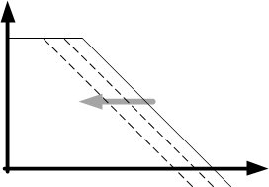
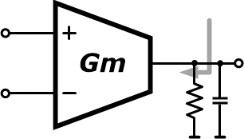
Load compensation (single stage amplifier)
^{Z}OUT
Single pole
-20dB/dec
|A|
^{V}IN
^{V}OUT
^{C}LD
C
LD
Freq
^{𝐺}𝑚^{𝑅}𝑙𝑑
1+jω/ω_{𝑐}
𝐺
𝑚
𝐴 = 𝐺 𝑍 ≅
𝜔 =
𝑣
𝑚 out
𝐶
^{𝐶}𝐿𝐷
Large load capacitors simply reduce Gain-Bandwidth but the Phase Margin still 90° Stable but limited gain and output impedance is high.

Slide 34
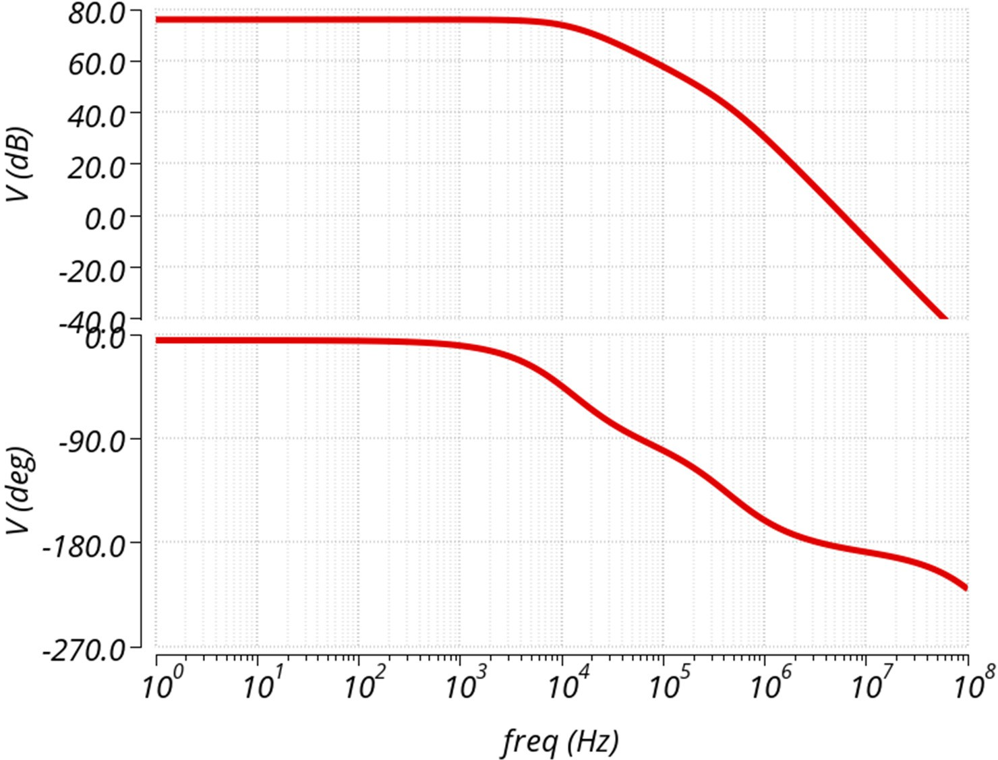
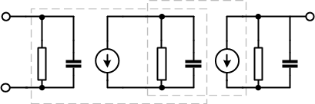
Two stage amplifier: Frequency response
1
^{𝑅}𝐿𝐷^{𝐶}𝐿𝐷
𝐴 = 𝑔𝑚 𝑔𝑚 𝑅 𝑅
𝑝 =
0
𝑖 𝑜 𝐸Q 𝐿𝐷
2
1
^{𝑅}𝐸Q^{𝐶}𝐸Q
𝑝 =
1
^{V}IN-
^{V}IN+
^{V}OUT
Cross over frequency
^{C}LD
^{R}LD
^{C}EQ
φ_{M}=0°
^{V}OUT ^{R}LD ^{C}LD
^{R}IN ^{C}IN
^{R}EQ ^{C}EQ
p
V
IN
3
gm_{i}
gm_{o}

Slide 35
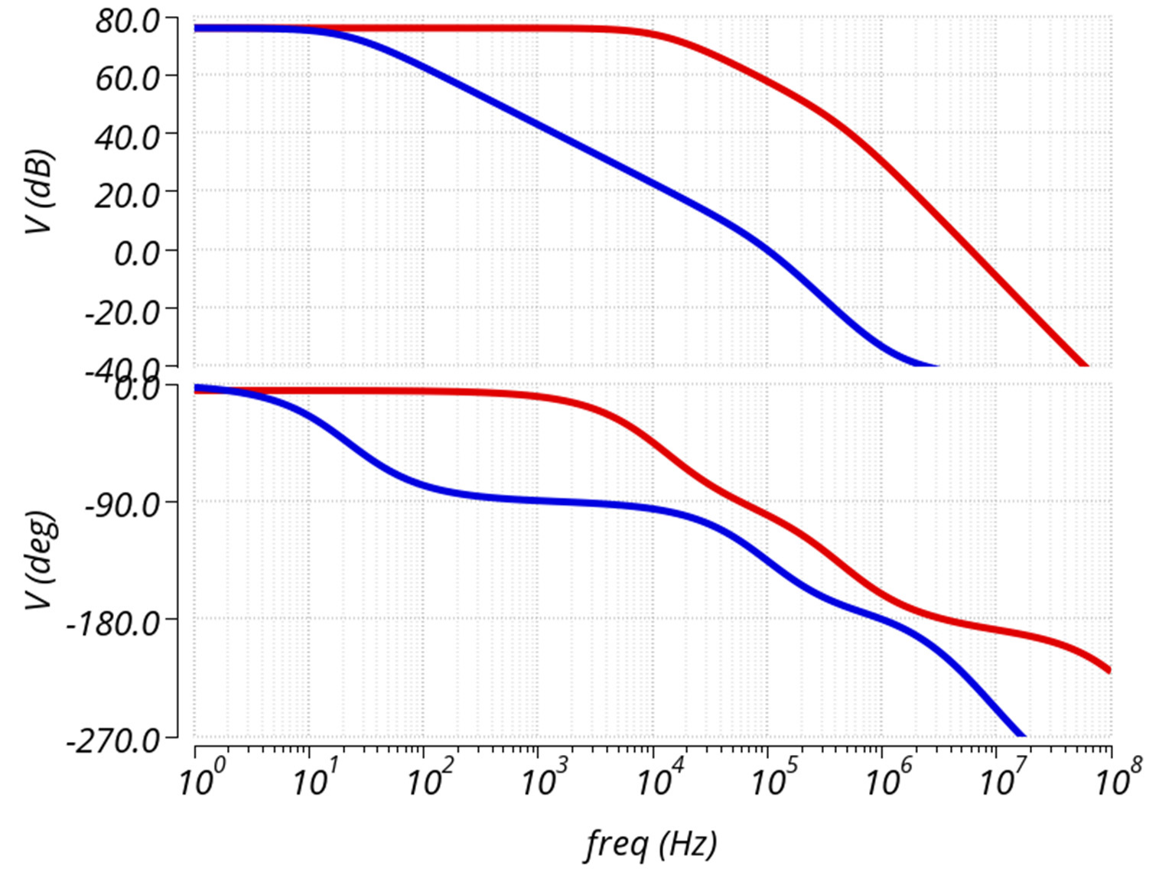
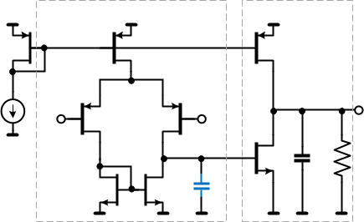
Two stage amplifier: Shunt compensation
C_{C}=5nF
C_{C}=1pF
^{V}OUT
^{V}IN-
^{V}IN+
C
^{C}LD ^{R}LD
C
φ_{M}=45°
φ_{M}=0°
Not practical for ICs.

Slide 36
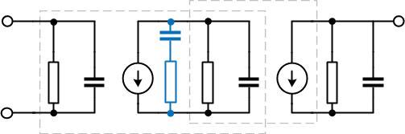
Parallel (lead) compensation ^{[3]}
^{V}OUT
^{R}LD ^{C}LD
Introduces zero that cancels out the pole generated by load
Best for power efficiency
Cc required can be large
Load conditions are not always controllable
Error in cancellation introduces pole/zero doublet which can lead to settling delays
^{R}IN ^{C}IN
C
^{R}EQ ^{C}EQ
V
C
IN
R_{C}
gm_{i}
gm_{o}
Original poles (w/o comp):
1
1
𝑝 =
𝑝 =
1
^{𝑅}𝐸Q^{𝐶}𝐸Q
2
^{𝑅}𝐿𝐷^{𝐶}𝐿𝐷
Compensated poles/zeros:
1
^{𝑅}𝐸Q^{𝐶}𝐶
1
^{𝑅}𝐶^{𝐶}𝐸Q
1
^{𝑅}𝐸Q^{𝐶}𝐸Q
1
𝑅_{𝐶}𝐶_{𝐶}
𝑝 =
𝑝 =
𝑧 =
𝑧 =
1
2
1
2
Select R_{C}C_{C} = R_{LD}C_{LD}
37

Slide 37
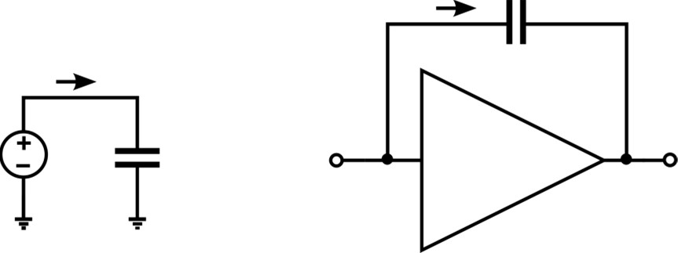
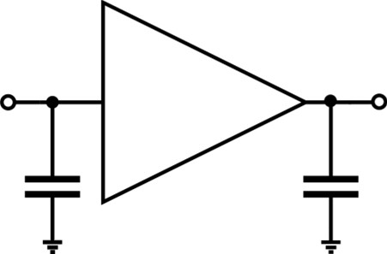
Miller Effect
𝑑𝑉
i
𝑖 = 𝐶 _{𝑑𝑡}
Identified in 1920 [2]
C
F
Negative feedback with a capacitor as the feedback element
V
C
v
-A_{V}
-Av
_{𝑖 = 𝐶} 𝑑[𝑣− (−𝐴_{𝑉}𝑣)] _{= 𝐶} 𝑑𝑣[1 + 𝐴_{𝑉}] _{= 𝐶}
𝑑𝑣
Impedance seen at input is multiplied by gain
  Gain is also function of frequency
  A capacitor is effectively a short at high frequencies ⇒ phase is inverted (negative to positive)
𝑑𝑡 𝑑𝑡 ^{𝑀} 𝑑𝑡
-A_{V}
C₁
C₂
1+ 𝐴
𝐶₁ = 𝐶_{𝐹} 1 + 𝐴
𝐶₂ = 𝐶_{𝐹}
𝐴

Slide 38
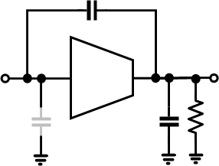
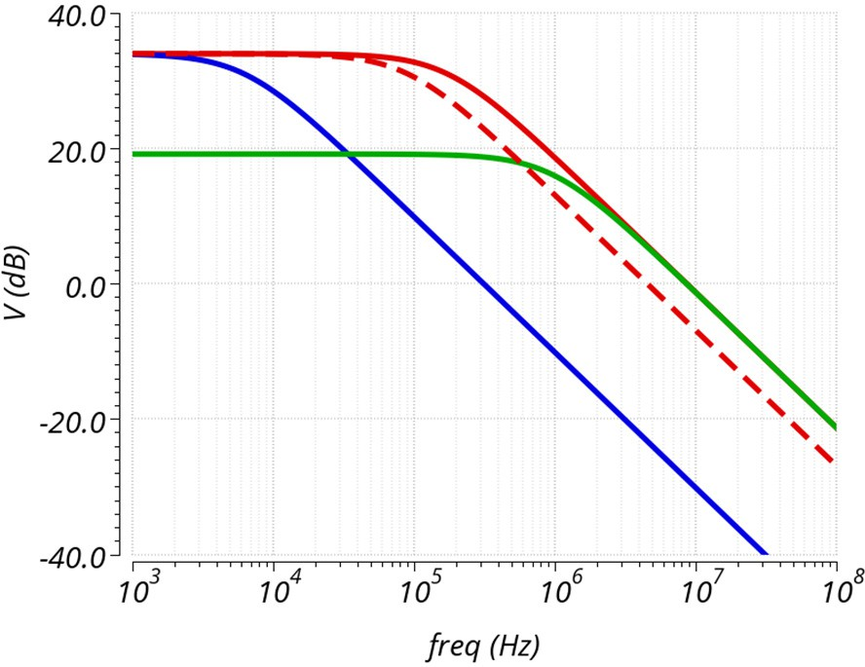
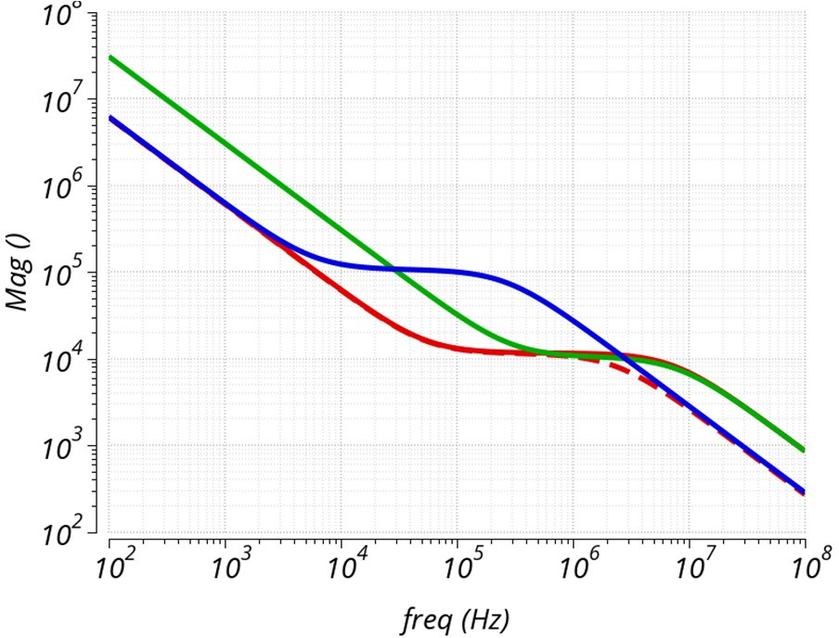


Miller Capacitor
Gm Cm
C
ML_ BW =
⋅
m
2π (Cld + Cm) Cpar + Cm
-Gm
Cm
^{V}IN
^{V}OUT
ML _ Gain ~ Gm ⋅ Rld ⋅
Cpar + Cm
^{Z}IN
^{C}par
^{C}LD
^{R}LD
|ML|
|Zin|
^{R}LD
^{C}par
^{R}LD
^{C}LD
^{C}LD
^{C}par
R_{IN}’~ C_{LD}/(Cm*Gm)

Slide 39
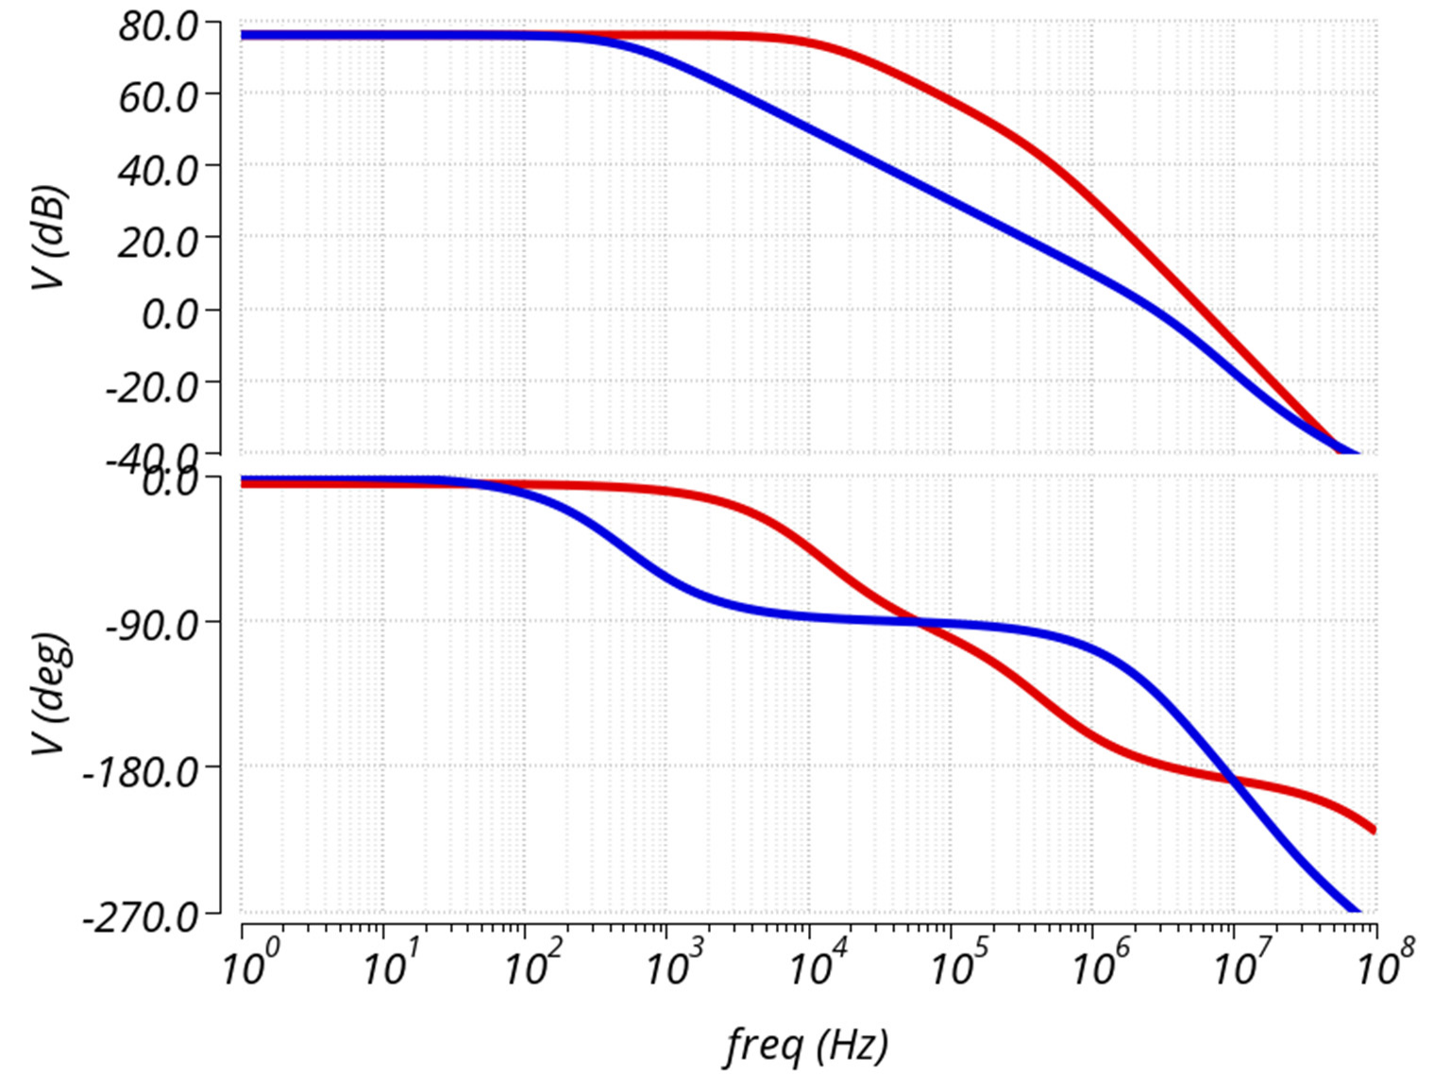
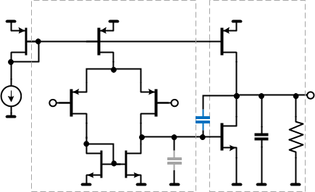
Two stage amplifier: Miller compensation
Uncompensated
Miller compensated CM=6pF
gm_{i}
gm_{o}
^{V}IN-
^{V}IN+
^{V}OUT
C_{C}
^{C}EQ
^{C}LD ^{R}LD
φ_{M}=45°
φ_{M}=0°
Very effective. Most commonly used compensation technique.

Slide 40
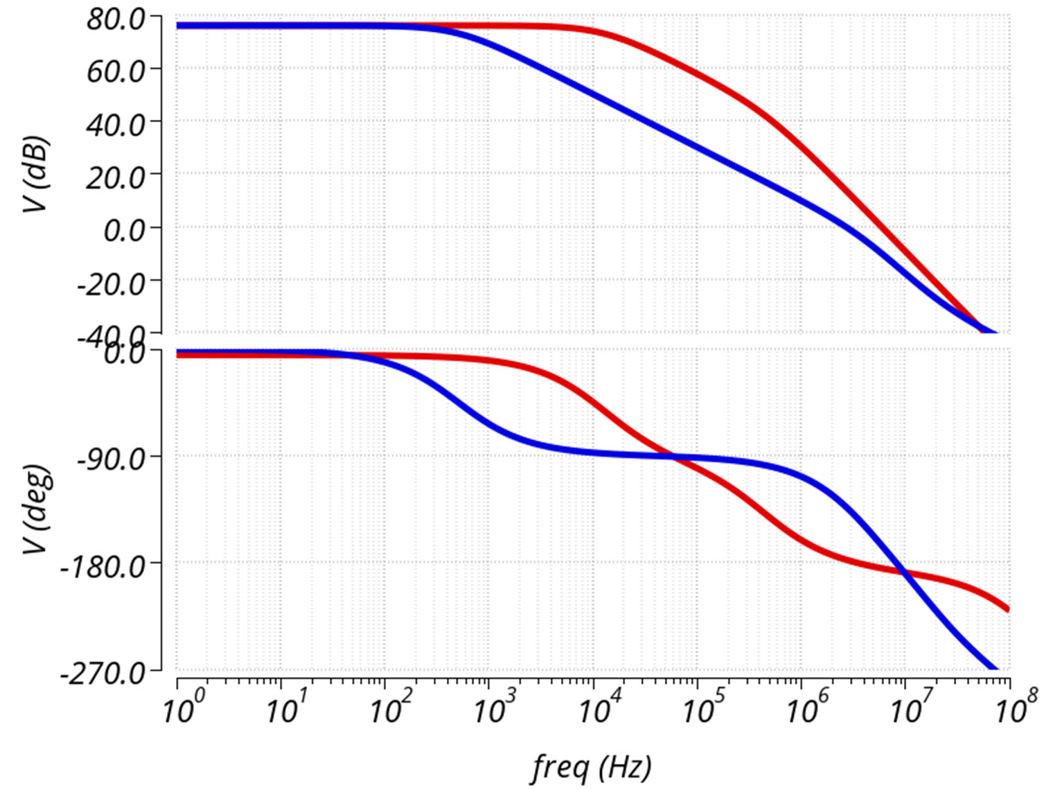
Two stage amplifier: Miller compensation
p1
Uncompensated
p2
Poles moved apart due to Miller Compensation
Miller compensated
1
Dominant pole:
^{𝑝1 = 𝑔𝑚}𝑜^{𝑅}𝐸Q^{𝑅}𝐿𝐷^{𝐶}𝐶
₌ 𝑔𝑚_{𝑜}
Output pole:
𝑝
2
^{𝐶}𝐿𝐷
But introduced right half plane zero that increases magnitude and reduces
phase: ₌ 𝑔𝑚_{𝑜}
𝑧
1
𝐶_{𝐶}
₌ 𝑔𝑚_{𝑖}
Unity gain bandwidth: 𝜔
𝐶
𝐶_{𝐶}

Slide 41
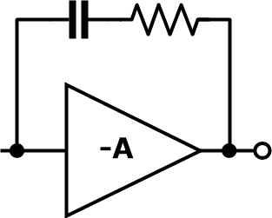
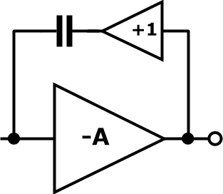
Methods to eliminate the RHP zero
There are two parallel paths two output ⇒ RHP zero in frequency response. RHPZ provides gain but phase loss ⇒ strong degradation of stability
  Can use a buffer to eliminate feed-forward action. Output impedance of buffer is not negligible.
  Can add a resistor to cancel out the zero. Typically select Rz to be equal to output transistor transconductance.
voltage
time
C_{C} R_{Z}
C_{C}
1
𝑧 =
1
𝐶 ( ¹ − 𝑅 )
𝐶
𝑔𝑚_{𝑜}
𝑧
42

Slide 42

Two Stage Amplifier: Compensation Comparison
gm_{i}
gm_{o}
^{V}IN-
^{V}IN+
^{V}OUT
C_{C}
^{C}EQ
^{C}LD ^{R}LD
Uncompensated C_{LD}=0
Uncompensated C_{LD}=50pF
Shunt Compensated (5nF)
Miller Compensated (5pF)

Slide 43
Outline
Introduction and background
Refresher on feedback theory, bode plots
Types of frequency compensation
A practical design example of a two stage amplifier
Alternative (advanced) compensation schemes
Practical tips and suggestions
Nested Miller Multipath nested Miller Advanced Miller topics Useful combinations

Slide 44

Two Stage Amplifier Miller Comp (revisited)
C_{M}
Single dominant pole response set by C_{M} as long as Miller loopgain (ML) is above 1
Second pole, at output node: ω₂~G2/(C_{LD}(1+Cpar/C_{M}))
Load capacitance and parasitics impact ML bandwidth! Make C_{M}>Cpar to maximize.
Feedforward causes RHP zero at ωz=G2/C_{M}
Load resistance lowers Miller-loop gain!
ML
G1
-G2
C
par
C
LD
𝐺2 𝐶_{𝑀}
𝑀𝐿
𝐵𝑎𝑛𝑑𝑤𝑖𝑑𝑡ℎ
~
⋅
2𝜋(𝐶𝐿𝐷 + 𝐶𝑀) 𝐶𝑝𝑎𝑟 + 𝐶_{𝑀}
Keep ML_{Gain} above 1
𝐶_{𝑀}
𝑀𝐿
𝐺𝑎𝑖𝑛
~ 𝐺2 ⋅ 𝑅 ⋅
𝐿𝐷
𝐶𝑝𝑎𝑟 + 𝐶𝑀

Slide 45

Cascoded Miller ^{[8,9]}
Adds gain to Miller Loop ⇒ much improved load capacitance drive
Blocks the RHP zero
Cascode gm (MP) must be higher than G1 to be effective
Adds LHP zero (improves phase margin)
Can have stability issues when C_{LD}=C_{M} (poor damping in Miller-loop)
Watch for stability during slew (avoid operating MP w/o current)
C_{M}
MP
ML
G1
-G2
^{C}par
^{C}LD
𝐺2 𝐶_{𝑀}
𝑀𝐿
~
⋅
𝐵𝑎𝑛𝑑𝑤𝑖𝑑𝑡ℎ
2𝜋(𝐶𝐿𝐷 + 𝐶𝑀) 𝐶𝑝𝑎𝑟 +_{X}𝐶_{𝑀}
𝑔𝑚_{𝑀𝑃}
^{𝜔𝑧 =} 2𝜋⋅ 𝐶
𝑀

Slide 46

Split Cascoded Miller
Improved stability at Cld=CM
CM_{a}
CM=CMa+CMb
CMa/CMb typically around 1 to 6
CMb reduces cap load drive but improves Miller loop damping at small C_{LD}
Feedback around cascode (to increase gm) can eliminate need for CMb, but requires extremely high BW loop and stability during slewing not addressed
MP
CM_{b}
G1
-G2
^{C}par
^{C}LD

Slide 47

“Hybrid” Cascoded Miller
Increased (2x) effective Gm
Cascode Gm > input Gm
CM2x > CM1x for improved Cld drive
Avoid LHP zero by CM2a=CM2b and ^{Gm}MNC^{=Gm}MPC
Pole/zero doublets can exist if not met
Must be evaluated for different load capacitances and load currents!
^{M}PC
^{C}M2b
^{C}M1b ^{C}M1a
^{V}IN-
^{V}IN+
V
OUT
^{M}NC
C
M2a

Slide 48


Pole-Zero Doublets
voltage
time

Slide 49

Cascoded Miller: Reduce Gain ^{[10]}
Reduce 1st stage gain by R_{S}
Cascoded Miller reduces cap loading on first stage and increases Miller loop gain
Cld sets dominant pole at high C_{LD} and BW is reduced
Can have issue to drive resistive loads (not enough gain)
Watch for stability issues at C_{LD}=C_{M}!
Many examples in literature to control impedance over frequency of internal high impedance node [10,12,13,14 ..]
C_{M}
MP
ML
G1
-G2
R_{S}
^{C}par
^{C}LD

Slide 50


Cascoded Miller Comparison Simulations
Vout
Miller – no Cload Miller -- 500pF Cload Cascode – no Cload
Cascode -- 500pF Cload
time
Miller – no Cload Miller -- 500pF Cload
Cascode – 500pF Cload
Hybrid Cascode 0.5:0.5 -- 500pF Cload Hybrid Cascode 0.9:0.1 -- 500pF Cload

Slide 51
Need more gain ….

Slide 52


Additional gain stages
^{C}M2
G₂
C
V
G
M1
IN
1
G
3
|A|
R₀ C₀ R₀ C₀ R₀
^{C}LD
3 stages provide more gain, lower offset, wider input / output ranges, more current drive capability and lower distortion
They also lead to 3 high frequency poles that need to be compensated
For power efficiency always explore adding gain to existing stages (i.e. gain boost) before adding additional stages
More difficult to achieve in bipolar amplifier especially if need rail-to-rail operation (R_{π})
Log Freq.

Slide 53




Nested Miller Compensation
^{C}M1
Assure Miller always across negative FB
Each stage reduces bandwidth 2-3x
|A|
^{C}M2
G1
G2
-G3
^{C}par
^{C}par
^{C}LD
Log Freq.
3 stages ⇒ 3 high frequency poles ⇒ “Nested Miller compensation”
  Set inner loop (G2-C_{M2}-G3) ~2x amplifier bandwidth to assure C_{M1} ML gain.
  Output pole (G3/C_{LD}) should be yet ~2x higher than that
Concept extends to 4 or more stages, with BW of the inner loops ~doubling with the addition of each gain stage

Slide 54

Reverse Nested Miller Compensation
^{C}M1 ^{C}M2
G1
-G2
G3
^{C}par
^{C}par
^{C}LD
Good for power efficiency
Strong C_{LD} dependency due to limited gain in G3
Loading effects can be mitigated by isolation resistors
Non-inverting output stage!
55

Slide 55

Feed-forward Compensation
^{C}M1
^{C}ff
G1
G2
-G3
^{C}par
^{C}par
^{C}LD
C_{ff} bypasses G2 at high frequencies
Impedance looking into second stage is negative!
Look for distortion effects
Viola Schaffer
56

Slide 56



Feed-forward around a gain stage
|Vout/Vin|
Rs=R’!
^{C}LD
C_{ff}/(C_{ff}+C_{LD})
^{C}ff
^{V}IN
+G2
^{V}OUT
LHP zero G2/C_{ff}
^{Z}IN
^{C}par
^{C}LD
|Zin|
Also known as a negative impedance converter
R’= -(C_{ff}+C_{LD})/(C_{ff}*G2)
Source impedance must be larger than |R’|
Cld
R’
57

Slide 57




Multipath NM (Feedforward) Compensation ^{[3,4]}
Low frequency behavior determined by high gain path
Each stage introduces a pole
Combines the dynamic response and speed-to-power ratio advantage of a two-stage structure with the additional gain and better distortion of a three-stage amplifier
High frequency response dominated by feed-forward stage; offset and offset drift by the high gain path
Can be extended to multiple stages
Watch for large signal stability issues!
^{C}M1
^{C}M2
G1
G2
-G3
^{C}par
^{C}par
^{C}LD
Gff
High frequency behavior is dominated by feedforward path. Introduces LHP zero into frequency response.

Slide 58


Multipath Nested Miller Compensation
Great for power efficiency
Introduces pole-zero doublet that can lead to settling issues. To exactly cancel pole-zero doublet:
|A|
100
80
60
40
20
0
[dB]
G₁
₌ ^{C}M1
G C
10⁰ 10² 10⁴ 10⁶
₁₀₈ Log Frequency
ff M2
[Hz]
_{A} 0
Keep stich frequency close to bandwidth to mitigate effects of imperfect matching
Output impedance is complex! Can have issues with large load caps and driving ADCs.
-90
[deg]
-180
-270

Slide 59

Multipath Nested Miller Compensation
Compare 3 stage amplifiers
  Uncompensated
  Nested Miller compensated
  Multipath Nested Miller compensated
In example (50pF C_{LD})
  3x better bandwidth
  40 degrees more phase margin

Slide 60




External Techniques to Improve C_{L} Drive
In-loop Snubber
^{V}IN ^{Z}OUT
R_{X}
V
^{V}IN
OUT
^{V}OUT
C_{L}
R_{L}
R_{S} C_{S}
C_{F}
C R
L L
R_{F}
R
IN
Input Cap loading
^{R}IN
^{V}IN
C_{C}
Isolation
IN
V
Z
^{R}ISO
R
F
OUT
^{V}out R_{l}
C_{L}
^{C}IN
^{V}OUT

Slide 61



Output Impedance Frequency Response ^{[16]}
|Z_{O}|
Capacitive
Z_{O}
Z_{I}
Inductive
AV_{I}
^{Z}LD
Resistive
Log Freq.
Rail-to-rail output stages and multipath structures introduce complex output impedance
Region L_{O} appears inductive and can interact with capacitive loading

Slide 62
Outline
Introduction and background
Refresher on feedback theory, bode plots
Types of frequency compensation
A practical design example of a two stage amplifier
Alternative (advanced) compensation schemes
Practical tips and suggestions

Slide 63


Amplifiers have multiple feedback loops
[*] LM741 datasheet
[*] M. Degranuwe, J.Rijmenants, E.A.Vittoz, and D.Man,“Adaptive biasing CMOS amplifiers, ”IEEE JSSC,vol.SC-17,pp522–528, Jun 1982

Slide 64
Tips to design for stability
Limit the number of gain stages
  Each gain stage decreases achievable bandwidth
  Consider gain (impedance) boost
  Consider nested gain structure
Three or more stages can lead to conditional stability
  Use clamps
  Control gain
Assure stability of each FB loop for overall system stability
  Keep local loops single stage if possible
Use compensation capacitors sparingly
Consider gain reduction
Watch for transient states (i.e. start-up; saturation in bipolar; current limit etc.)

Slide 65


Gain (impedance boost)
d.
GAIN
c.
V
V
V
V
OUT
OUT
V_{B}
OUT
OUT
C_{L}
C_{L}
_{CL} V_{B}
C_{L}
b.
^{V}IN
a.
^{V}IN
^{V}IN
^{V}IN
a.
b.
c.
d.

Slide 66







Building blocks for fast local loops^{[5,6]}
Useful blocks to implement local control loops such as current limit
Don’t neglect common gate and current mode amplifiers

Slide 67

Decreasing gain
A way to reduce impact of secondary poles
  Decrease gain by resistor
  Add capacitance / impedance to stabilize
R_{L}
R_{L}
R_{L}
V_{i}
V_{i}
V_{i}
I₀=V_{GS}/R_{C}
C_{C}
I₀
R_{C}
R_{C}
I₀

Slide 68

Nested gain structure
Parallel low gain path for speed and stability and high gain path for accuracy
Vout
Vin
MP
MN
[*] V.Schaffer, M.Snoeij, M.Ivanov, D.Trifonov, “A 36V Programmable Instrumentation Amplifier with Sub-20uV Offset and CMRR in Excess of 120dB at All Gain Settings” IEEE JSSC, vol.44, July 2009.

Slide 69
Common conditions to watch for
Output stage operating conditions
  Voltage levels
  Sourcing or sinking current (change of transconductance)
  Close to triode
  C_{GS} changes
  Class AB circuit can introduce delays and non-symmetricity
Start-up conditions
Loading effects (voltage and current dependency)
Parasitic capacitances (C_{GS} C_{CB} are voltage dependent)
Parasitic inductances (i.e. wirebonds)

Slide 70



Pulsing nodes
Apply current pulse to high impedance nodes and observe settling behavior
Use ~10% bias current
Cadence – ‘Loop finder’ or ‘STB’ analysis
Voltage, V_{X}
V_{X}
^{I}TEST
time

Slide 71

Loading effects
Even simplest stage will introduce loading effects, parasitics and can transfer effects of subsequent stages
An ideal voltage controlled voltage source is very helpful for quick investigation (simulation only)
R_{L}
^{C}GD ^{V}OUT ^{C}GD
^{C}ff
R_{S}
^{V}IN
+G2
^{V}OUT
^{V}IN
^{C}GS
^{Z}IN
^{C}par
^{C}LD
^{C}SB

Slide 72

Taming High Impedance Nodes
A practical method for taming high impedance nodes:
  Set C_{c} very large (1F) - BFC
  Choose largest R_{c} to get desired step response
  Decrease C_{c} until step response starts changing
C_{C}
R_{C}
[*] M.Ivanov, M.Ismail, V.Ivanov, “High Slew Rate Micro-Power CMOS OTA with Class AB Input Stage” IEEE Xplore

Slide 73
Miller-Loop damping
Multiple gain stages in the Miller Loop require special attention
Many techniques exist to control impedance of high impedance nodes [10,12,13,14 ..]
Worst case may not be at max or min load current and capacitance!
Class AB biasing loop can degrade damping. This is load current dependent!
A suggested design approach:
  Find worse case Iload and Cload using parametric analysis and step responses
  Look for peaking in unity gain response
  Use STB analysis in Miller Loop (with all other outer loops opened) at worst case point. Keep phase margin>30 degrees (over corners).

Slide 74
Large signal instability
Stable for small input signal / unstable for large step
Caused by linear range mismatch in 3- and more stage structures
Common cause of silicon revision
  To fix:
    Use passive or active clamps
    Transconductors with wide input stage
G1
G2
-G3
Gff

Slide 75


Large signal stability
Stable AC
Unstable transient
|A| ∠A
Voltage
0dB
-180˚
frequency
time
76

Slide 76




Beware of Parasitic Effects
Bondwire inductance
Pad capacitance
C_{DG}, C_{CB} vs voltage
Capacitance
FQP30N06L
^{C}DS^{+C}GD
Bondwire
^{C}GS^{+C}GD
C_{GS}=0V
^{C}GD
Bondpad
Drain-Source Voltage

Slide 77
Still Oscillates – where to start
Disconnect “unnecessary” loops if possible
Oscillation frequency
  Close to unity gain bandwidth
    Parasitics
    Feedforward RHP zero
    Loss of Miller loop gain
  Lower frequency
    Conditional stability
    Overdriven gain stage
    Saturated bipolar device
    Significant loss of Miller loop gain (i.e. cascode transistor)
  Higher frequency
    Parasitic inductances, negative impedance
    Unintended positive feedback
    Local feedback loops

Slide 78
Papers to see at ISSCC 2021
31.4 ‘A Chopper-Stabilized Amplifier with -107dB IMD and 28dB Suppression of Chopper-Induced IMD’ T. Rooijers, S. Karmakar, Y. Kusuda, J.
H. Huijsing, K. A. A. Makinwa
5.6 ‘A 25A Hybrid Magnetic Current Sensor with 64mA Resolution,
1.8MHz Bandwidth, and a Gain Drift Compensation Scheme’ A. Jouyaeian, Q. Fan, M. Motz, U. Ausserlechner, K. A. A. Makinwa
5.5 ‘A 770 kS/s Duty-Cycled Integrated-Fluxgate Magnetometer for Contactless Current Sensing’ P. Garcha, V. Schaffer, B. Haroun, S. Ramaswamy, J. Wieser, J. Lang, A. Chandrakasan
5.8 ‘A 5V Dynamic Class-C Paralleled Single-Stage Amplifier with Near-Zero Dead-Zone Control and Current-Redistributive Rail-to-Rail Gm-Boosting Technique’ S-T. Koh, J-H. Lee, G-G. Kang, H. Han, H-S. Kim

Slide 79
References
H. Nyquist, “Regeneration Theory,” Bell System Technical J., vol. 11, no.1, pp. 126-147, 1932.
John M. Miller, "Dependence of the input impedance of a three-electrode vacuum tube upon the load in the plate circuit," Scientific Papers of the Bureau of Standards, vol.15, no. 351, pages 367-385 (1920)
R.Eschauzier “Wide Bandwidth Low Power Operational Amplifiers”, Delft University Press, 1994.
R.Eschauzier, L.Kerklaan, J.H.Huising, “A 100-MHz 100dB Operational Amplifier with Multipath Nested Miller Compensation Structure”, IEEE JSSC, Dec. 1992, pp. 1709-1717.
V.Ivanov, I.Filanovsky , “Operational Amplifier Speed and Accuracy Improvement”, Kluwer, 2004.
V.Ivanov, “Analog Design Methodology – Practical Techniques for Frequency Compensation”, Mead 2020
N. Mehta, J.H.Huijsing, V. Stojanovic, “1-mW Class-AB Amplifier with -101 dB THD+N”, IEEE JSSC, Apr. 2019,
pp. 948-958.
J.Wieser, R. Reed, “Current Source Frequency Compensation for a CMOS Amplifier” US Patent 4,484,148.
B.K. Ahuja, “An Improved Frequency Compensation Technique for CMOS Operational Amplifiers”, IEEE JSSC, Dec. 1983, pp.629-633.
R.J. Reay, G.T. Kovacs, “An Unconditionally Stable Two-Stage CMOS Amplifier”, JSSC, May 1995, pp. 591.
G. Palumbo, S. Pennisi, “Design Methodology and Advances in Nested-Miller Compensation”, IEEE Transactions on Circuits and Systems, July 2002, pp. 893-903.
V. Dhanasekaran et al., “Design of Three-Stage Class-AB 16W Headphone Driver Capable of Handling Wide Range of Load Capacitance”, IEEE JSSC, June 2009.
A.K. Leung et al., “Damping-Factor-Control Frequency Compensation Technique for Low-Voltage Low-Power Large Capacitive Load Applications”, ISSCC 1999.

Slide 80
References
X.Peng, W.Sansen, “AC Boosting Compensation Scheme for Low-Power Multistage Amplifiers”, IEEE JSSC, Nov. 2004.
D.M. Monticelli, “A quad CMOS single-supply op amp with rail-to-rail output swing”, IEEE JSSC, Dec. 1996.
C.Wells, M.Oljaca, “Modeling the output impedance of an op amp for stability analysis”, Analog Applications Journal
https://lpsa.swarthmore.edu/Nyquist/Nyquist.html
Dr Phil Allen – lecture notes
Art Key, Tim Green, “Analog Engineer’s Pocket Reference” www.ti.com/analogrefguide
B. Razavi, “Design of Analog CMOS Integrated Circuits”, McGraw-Hill, 2000, 2017.

Slide 81




Examples of impedance control

Slide 82






Examples to improve load capacitance drive

Slide 83



2-Stage Amplifier: Stable with any Cld
85

